Slide 1
Chapter 13
Logistic Regression, Part 2

Slide 2
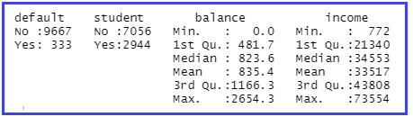
Dataset: Default
install.packages("ISLR")
Also need: caret, MASS, ROCR
Import Default.csv
summary(Default)
Response variable: default (on credit card)
Note: No missing values.

Slide 3
First: train-test partition of data (use caret package)
set.seed(430)
inTrain <- createDataPartition(Default$default, p = 0.75, list = FALSE)
default.train <- Default[inTrain,]
default.test <- Default[-inTrain,]
Check to see if training and testing datasets are similar.
default.train$trainortest <- rep("train",nrow(default.train))
default.test$trainortest <- rep("test", nrow(default.test))
default.all <- rbind(default.train, default.test)

Slide 4
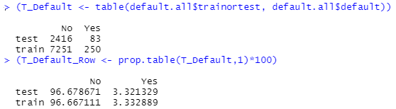
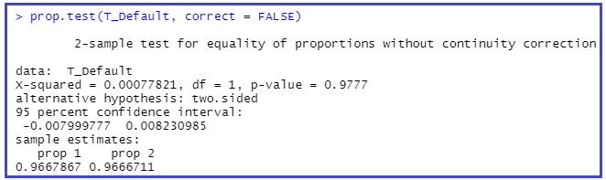
Comparing testing and training datasets

Slide 5
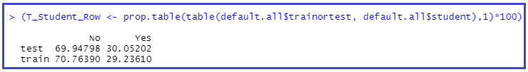

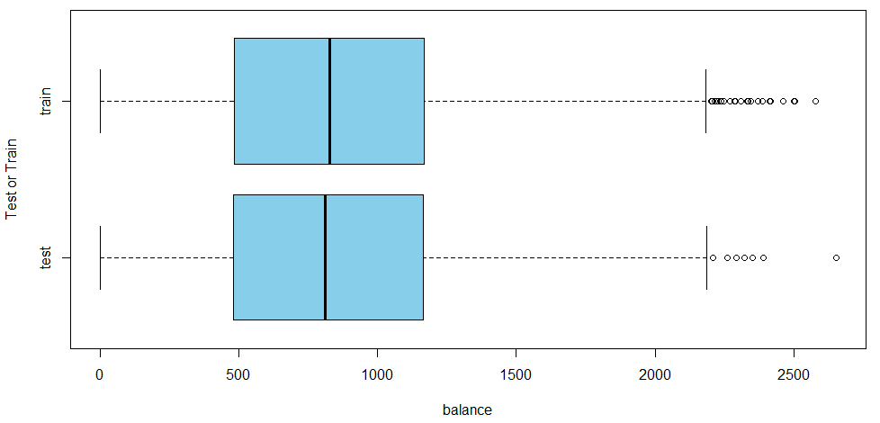
Compare test-train for other variables; Why????

Slide 6

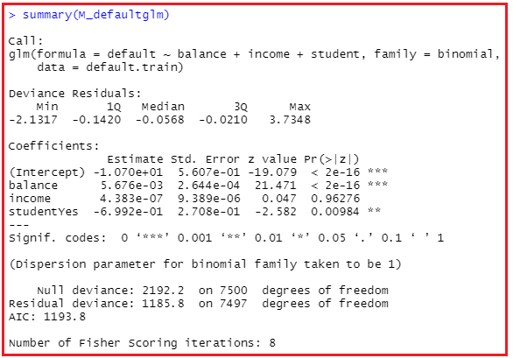
Fitting the logistic regression model

Slide 7
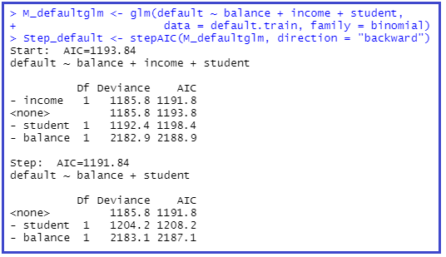
Stepwise Logistic Regression (example)
Already fit

Slide 8
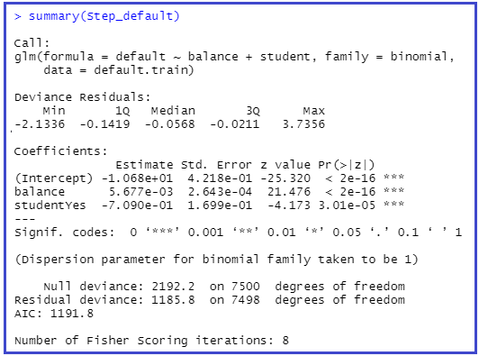
Model predictors: balance and student
“pseudo” R² = 1 – 1185.8/2192.2
Notes:
“pseudo R^2 = 1 – (1185.8/2192.2) = 0.459 – treat like R^2 in linear regression

Slide 9







Determining a cutoff for classification
True positive (TP)
True negative (TN)
False positive (FP)
False negative (FN)
Notes:
Default for predict is type = “link”. Need to decide on cutoff (or threshold) for classifying “Yes” for default. Can use ifelse. We need to discuss if that is the best cutoff. Make a table of predicted and actual values (Table_train).
The error rate is (FP + FN)/(TP + TN +FP + FN)

Slide 10
Calculation of training classification error rate
Notes:
Can create a function to compute the error rate.

Slide 11


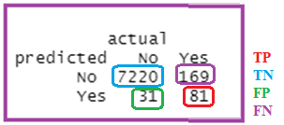
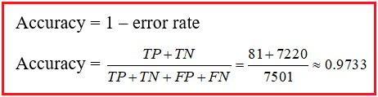


Other metrics (we’ll need caret package)
True positive rate
True negative rate
Notes:
Return to our Table_train.
True positive rate or sensitivity: probability that model predicts positive outcome, for outcomes that are actually positive. Column proportion pred pos under condition that the actual outcome is positive (2nd column).
True negative rate or specificity: probability that model predicts negative outcome, for outcomes that are actually negative. Column proportion pred neg under condition that the actual outcome is negative (1st col).
1 – specificity = False positive rate = FP/(TN +FP) – probability that model predicts positive outcome, for outcomes that are actually negative.

Slide 12
Can we do better with a different cutoff?: Check how we do with testing data (confusionMatrix)
get_logistic_pred <- function(mod, data, res = "y", pos = 1, neg = 0, cut = 0.5){
probs = predict(mod, newdata = data, type = "response")
ifelse(probs > cut, pos, neg)
}
test_pred_10 = get_logistic_pred(Step_default, data = default.test, res = "default",
pos = "Yes", neg = "No", cut = 0.1)
test_pred_50 = get_logistic_pred(Step_default, data = default.test, res = "default",
pos = "Yes", neg = "No", cut = 0.5)
test_pred_90 = get_logistic_pred(Step_default, data = default.test, res = "default",
pos = "Yes", neg = "No", cut = 0.9)
T_test_10 <- table(predicted = test_pred_10, actual = default.test$default)
T_test_50 <- table(predicted = test_pred_50, actual = default.test$default)
T_test_90 <- table(predicted = test_pred_90, actual = default.test$default)
test_con_mat_10 = confusionMatrix(T_test_10, positive = "Yes")
test_con_mat_50 = confusionMatrix(T_test_50, positive = "Yes")
test_con_mat_90 = confusionMatrix(T_test_90, positive = "Yes")

Slide 13
Code for calculating Accuracy, Sensitivity, Specificity for different cutoffs using testing data (continued)
metrics = rbind(
c(test_con_mat_10$overall["Accuracy"],
test_con_mat_10$byClass["Sensitivity"],
test_con_mat_10$byClass["Specificity"]),
c(test_con_mat_50$overall["Accuracy"],
test_con_mat_50$byClass["Sensitivity"],
test_con_mat_50$byClass["Specificity"]),
c(test_con_mat_90$overall["Accuracy"],
test_con_mat_90$byClass["Sensitivity"],
test_con_mat_90$byClass["Specificity"]))
rownames(metrics) = c("cut = 0.10", "cut = 0.50", "cut = 0.90")
metrics

Slide 14

Results
True Pos. Rate
1 – False Pos Rate
What do you notice as cut increases?
Accuracy highest at cut = 0.5.
Sensitivity decreases as cut increases. (Why?)
Specificity increases as cut increases. (Why?)
Useful if we are interested in a particular error instead of giving them equal weight.
Instead of manually checking cutoffs, we can create an ROC curve (receiver operating characteristic curve), which will sweep through all possible cutoffs, and plot sensitivity and specificity. (Let’s go back to model building on the training data.)
You will need the ROCR package.

Slide 15
ROC (receiver operating characteristic) curve (code)
Install.packages(“ROCR”)
pred <- predict(Step_default, type = "response")
predObj <- prediction(pred, default.train$default)
rocObj <- performance(predObj, measure = "tpr", x.measure = "fpr")
aucObj = performance(predObj, measure = "auc")
auc = aucObj@y.values[[1]]
auc
plot(rocObj)
plot(rocObj,colorize=TRUE,print.cutoffs.at=seq(0,1,0.1),
text.adj=c(-0.2,1.7), main=paste("Area under the curve:",auc))

Slide 16
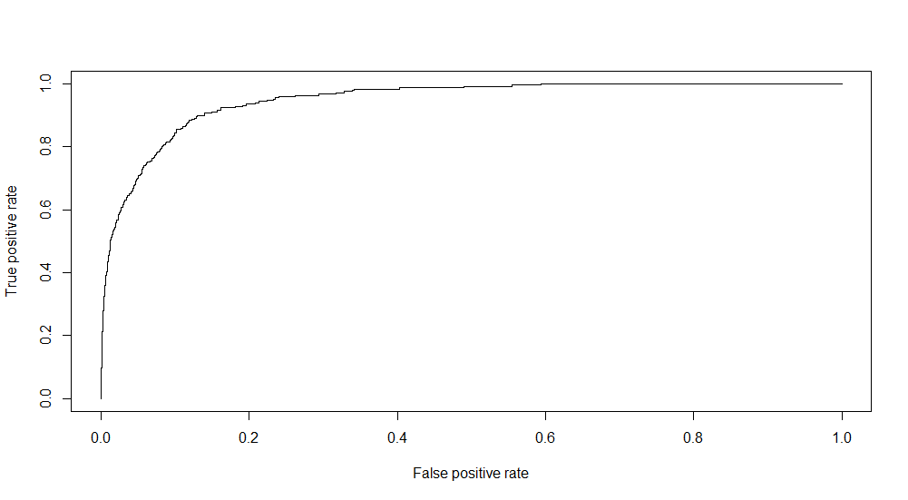
Basic ROC curve
Notes:
Want as much as possible to choose a cutoff that maximizes the true positive rate and minimizes the false positive rate (or maximizes the sensitivity).
The ROC curve is produced by calculating and plotting the true positive rate against the false positive rate for a single classifier model at a variety of thresholds.

Slide 17
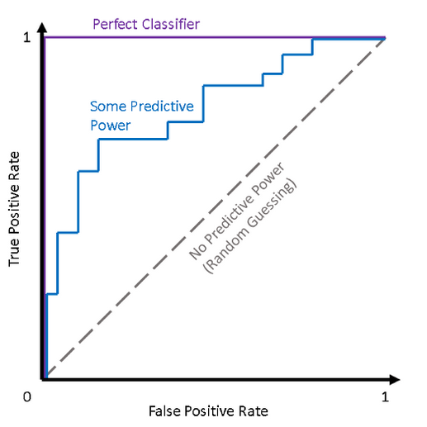
Interpreting ROC Curve
Make cutoff so low, model classifies
all records as positive. (i.e., make cutoff = 0)
Correctly classified all positive records and
incorrectly classified all negative records.
(0.75,1)
TP rate = FP rate
(0,0.2)
(0,0)
Notes:
Why is purple graph a perfect classifier? True positive rate 1.0, false positive rate 0.0.
Want a classifier that maintains a high true positive rate while also having a low false positive rate – this ideal classifier would “hug” the upper left corner, much like the purple line.
Single metric, AUC. Higher the AUC, better the classifier performs. No predictive power AUC = 0.5; perfect classifier, AUC = 1.0.
Look at (1,1) red dot. Make cutoff so low that every record classified at Pos. Then TP rate = 1 (all positives are correctly classified as positive) and FP rate = 1 (all negative are incorrectly classified as positive)
Brown dot at (0.75, 1). To left of dotted line, proportion of correctly classified records as positive (TP) is greater than the proportion of records that were incorrectly classified as positive (FP)
Green dot (0,0.2) correctly classifies 20% of the positive records, and 100% of the negative records.
Purple graph – vertical line -- specificity = 1.0 (100%) and horizontal line, sensitivity = 1 or 100%
Point at (0,0) represents the cutoff that results in 0 TPs and 0 FPs. This means you have a cutoff of 1, which means you will not correctly identify any positive cases. So, FP rate will be 0 and TP rate will be 0.

Slide 18
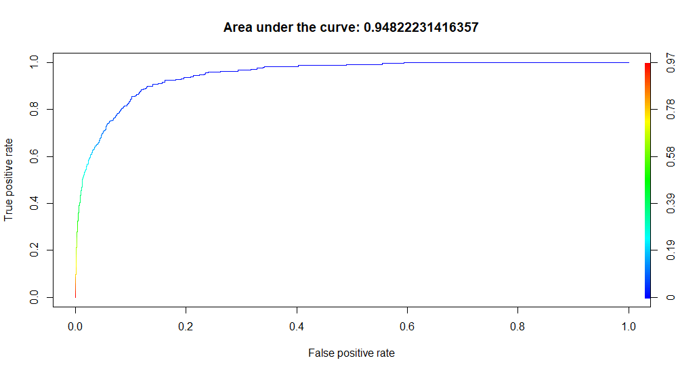
Adding to ROC curve
Notes:
Color coded: For low cutoffs, blue

Slide 19
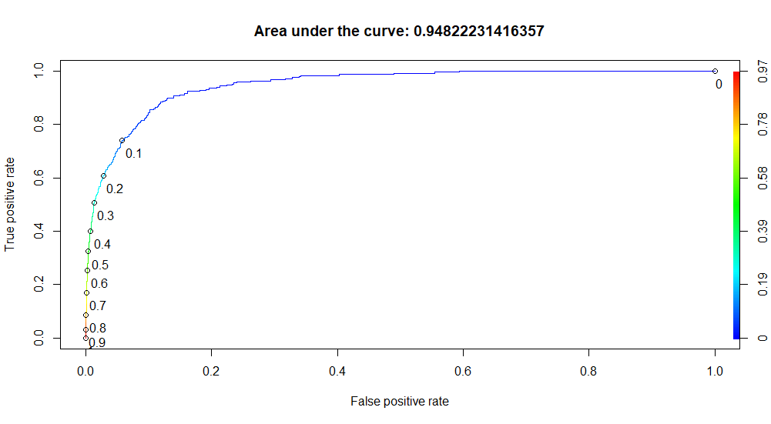
Adding to ROC curve
Notes:
If you move the cutoff to 0.2 or 0.1, you increase the true positives without having much affect on false positive rate. So, when used 0.10 on testing data, false positive rate was 0.0513. Still had a high accuracy and a much higher sensitivity!

